Slide 1
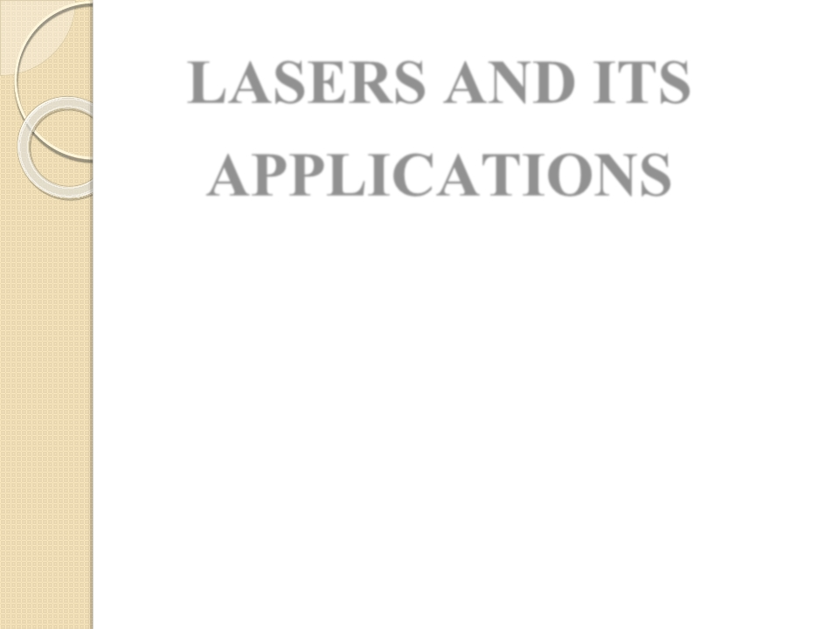
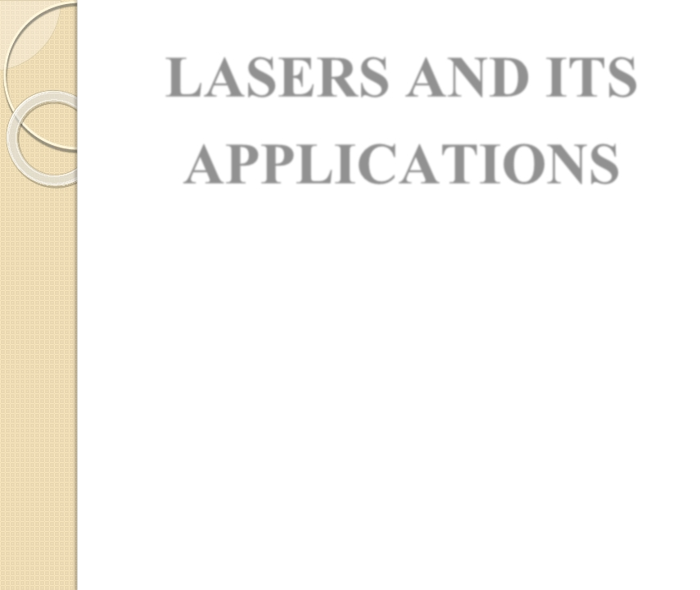
LASERS AND ITS
APPLICATIONS
By:
SUMAN KUMARI
ASSISTANT PROFESSOR
DEPARTMENT OF B. VOCATIONAL SPORTS
NUTRITION AND PHYSIOTHERAPY
KANYA MAHAVIDYALAYA KARKHODA

Slide 2


Contents
Introduction of laser
Principle of laser
Kinds of lasers
Construction and working of Ruby laser
Construction and working of He-Ne laser
Applications of lasers
a)Communication
b)Industry
c)Medicine
d)Military operation
1)
2)
3)
4)
5)
6)

Slide 3

7) Advantages of lasers
8) Disadvantages of lasers
9) Conclusion

Slide 4




Introduction
➢ The word laser is an acronym that stands
for “light amplification by the stimulated
emission of radiation”.
➢
➢
Lasers are essentially highly directional,
highly intense, highly monochromatic and
highly coherent optical sources.
Stimulated emission was postulated by
einstein as early as in 1917.

Slide 5



➢ In 1960 , a solid state ruby laser is
developed by maiman on this principle.
➢ In 1961, a gas state He-Ne laser is
developed by Ali javan and others in Bell
telephone laboratory.

Slide 6
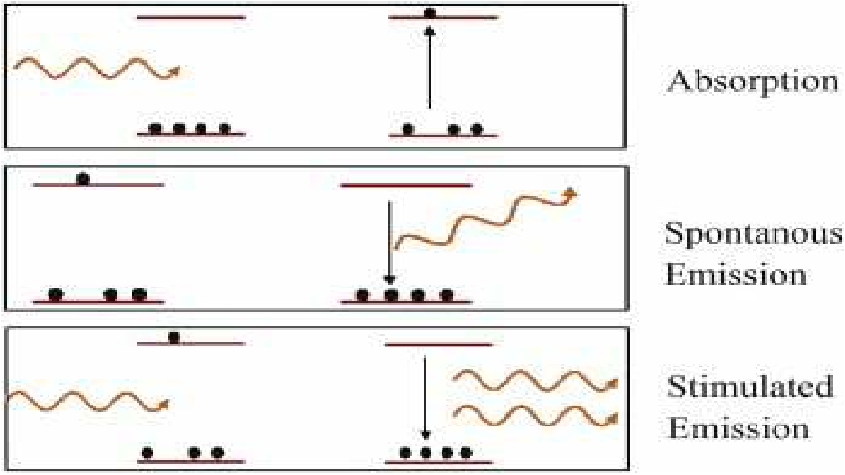
Principle of laser

Slide 7
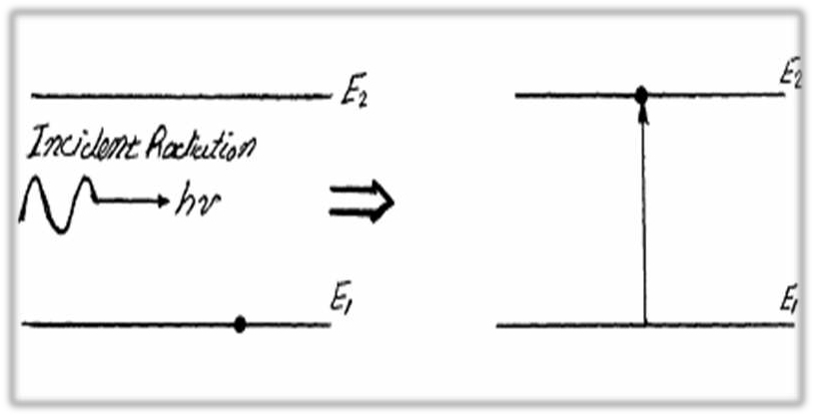
• The process of exciting the atom to higher energy
level by absorbing the stimulating incident photon is
known as stimulated absorption of radiation.

Slide 8
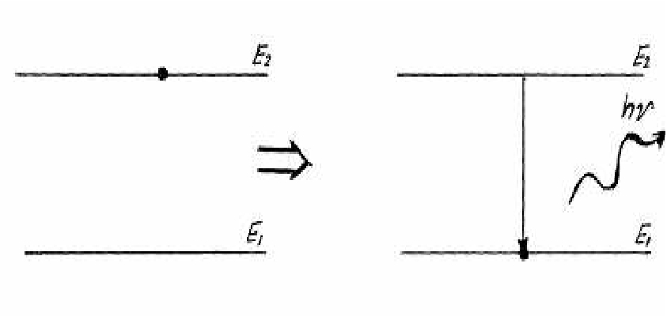
➢ The transition of an excited atom by itself to lower
energy level is known as spontaneous emission of
radiation.

Slide 9
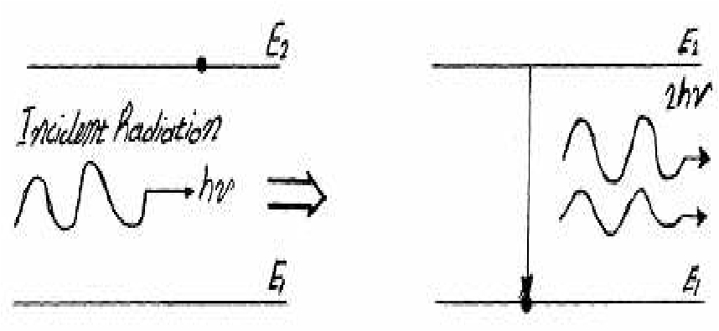
• The excited atom after getting stimulated by
the incident photon transits to lower energy
level by emitting photons is known as
stimulated emission of radiation.

Slide 10
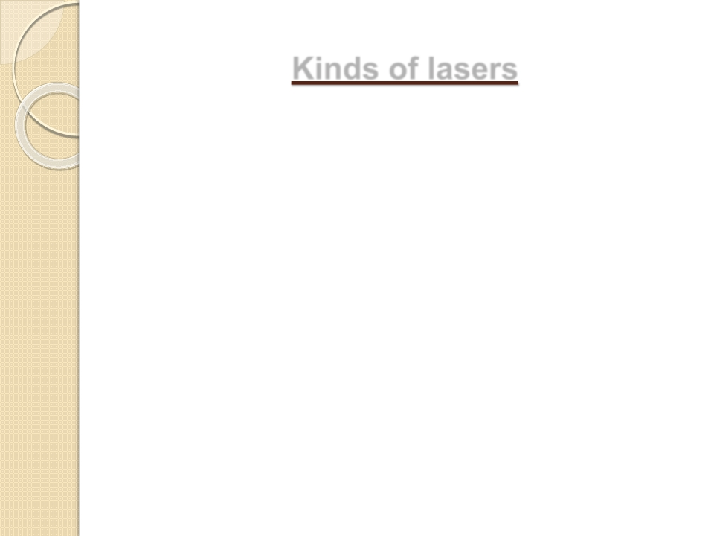


Kinds of lasers
Among the various kinds of lasers some important
types of lasers are listed below:
1) Solid state laser
: Ruby laser
2) Gas laser
: Co2 laser, He-Ne laser
3) Liquid laser
laser
4) Dye laser
5) Semiconductor laser
: Europium chelate
: Courmarin dye laser
: Inp laser

Slide 11
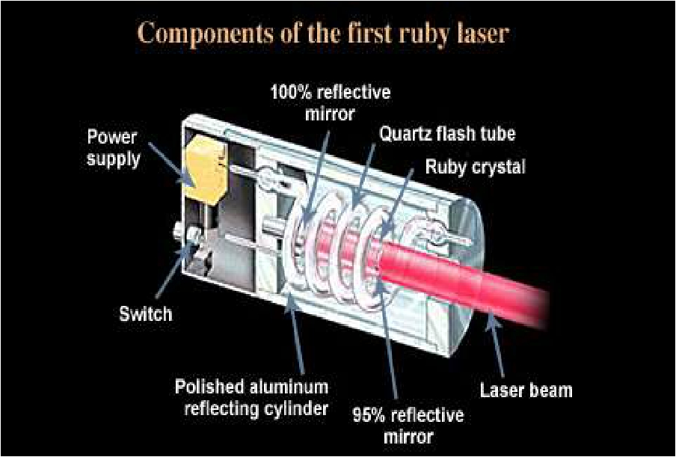
Construction and working of ruby laser

Slide 12

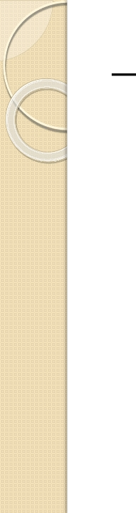
Construction :
➢ In ruby laser a cylindrical ruby rod
made up of aluminum oxide which is
doped with 0.05% weight of chromium
oxide.
➢ One end of rod is fully silvered and the
other one partially silvered so it act as
optical resonator.
➢ The rod is surrounded by a glass tube
which in turn is surrounded by the
helical flash lamp filled with xenon
gas.

Slide 13
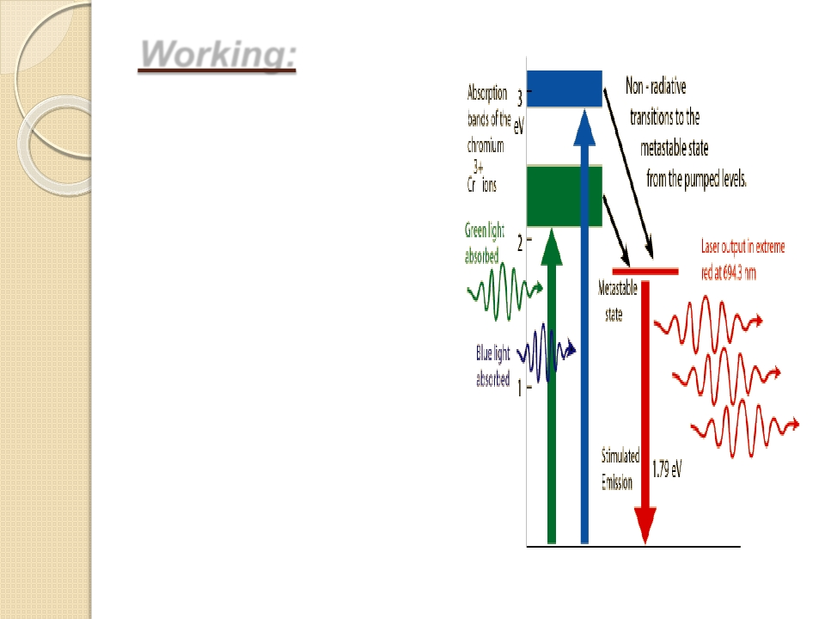

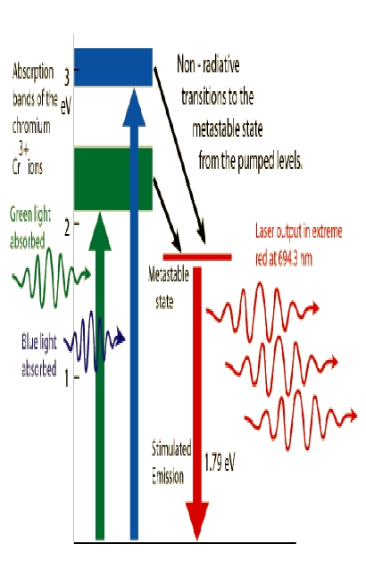
Working:



When the flash lamp
light will be flashed
on ruby rod the
chromium ions
excited to higher
energy states.
After staying for up
to 10 -8 second ions
get transmitted to
the metastable state.
The laser radiation of
a wavelength of
6943A 0 and laser
emission is pulsed
one.

Slide 14
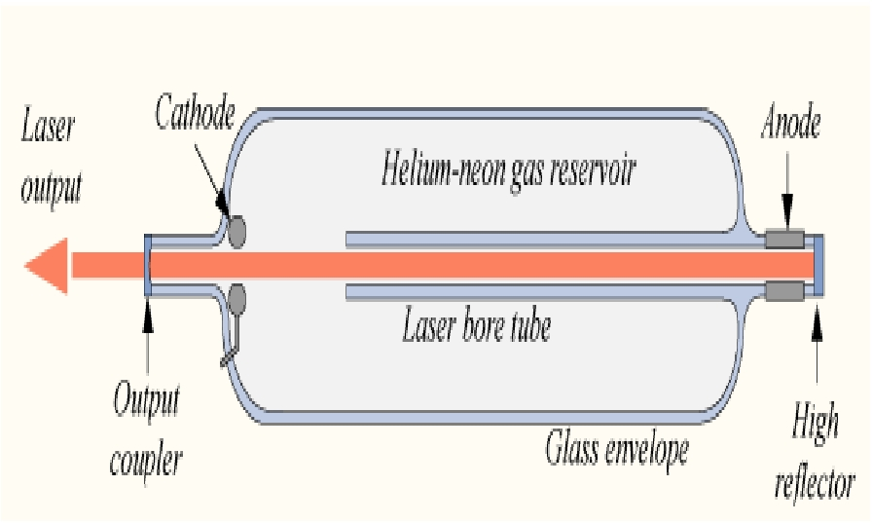
Construction and working of He-Ne
laser

Slide 15
Construction:
➢ A He-Ne laser consists of large and narrow
discharge tube filled with helium a and neon
gases in the ratio 10:1.
➢ The tube is enclosed between fully and
partially reflective mirrors which serve as
optical cavity.
➢ The two end windows are set at Brewster's
angle, so reflected radiations enter into the
tube become polarized.

Slide 16
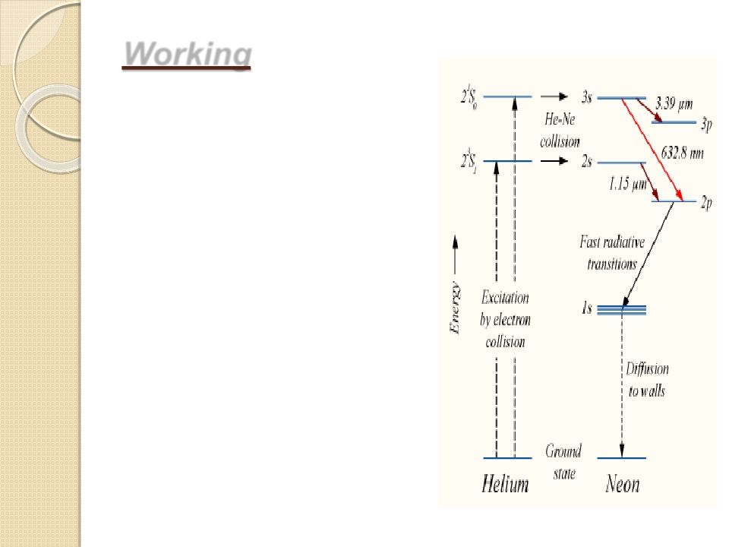

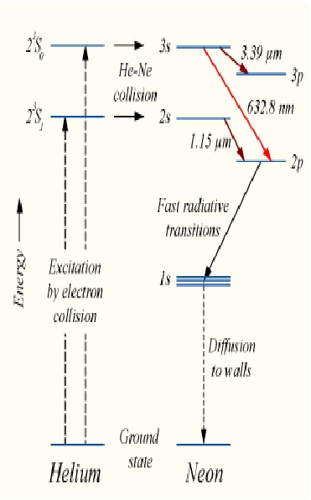
Working
➢
Helium atoms after
transferring their
energies to neon atoms
are excited to 2s and 3s.
➢ The population in theses
levels is more than those
in lower levels 2p and 3p.
➢ The emission of
radiation having
wavelength 6328A 0 is red
in colour and it gives
continuous emission of
radiation.

Slide 17
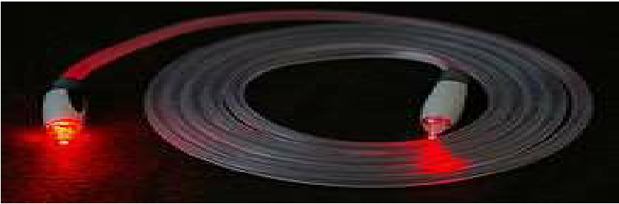
Applications of lasers
Lasers in communication:
In optical fiber communication laser bandwidth is
very high compared to the radio and microwave
communications.
➢ As it has large bandwidth,more amount of data can be
sent.
➢ More channels can be simultaneously transmitted.
➢ lasers are also used in other communication
devices,including high speed photo copiers and printers.

Slide 18
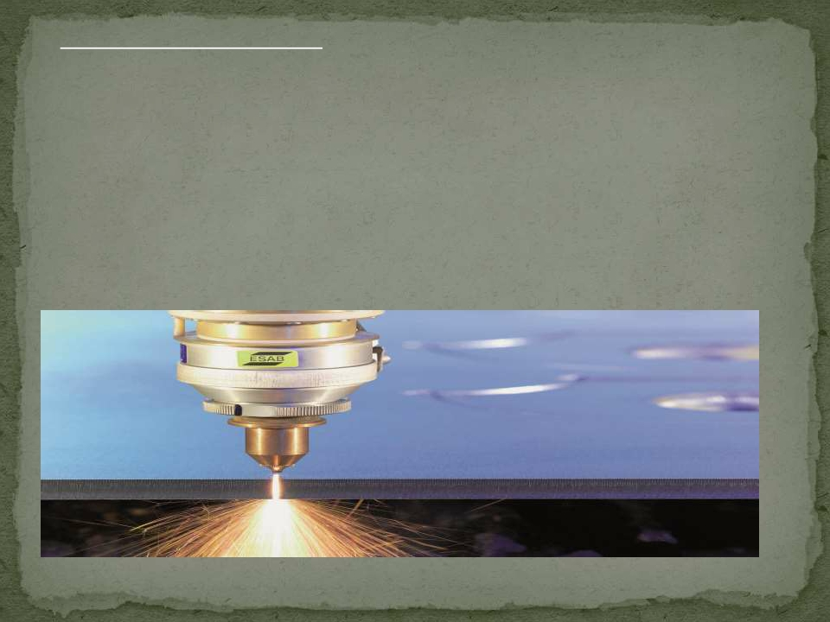
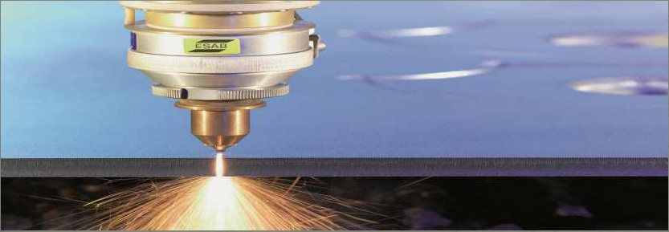
Lasers in industry:
➢ Lasers can be used to blast holes in diamonds and hard
steel.
➢ Lasers can cut,drill,weld, remove metal from surfaces and
perform these operations even at surfaces inaccessible by
mechanical methods.
➢ Lasers range finder is used to measure distance to making
maps by surveyors.

Slide 19
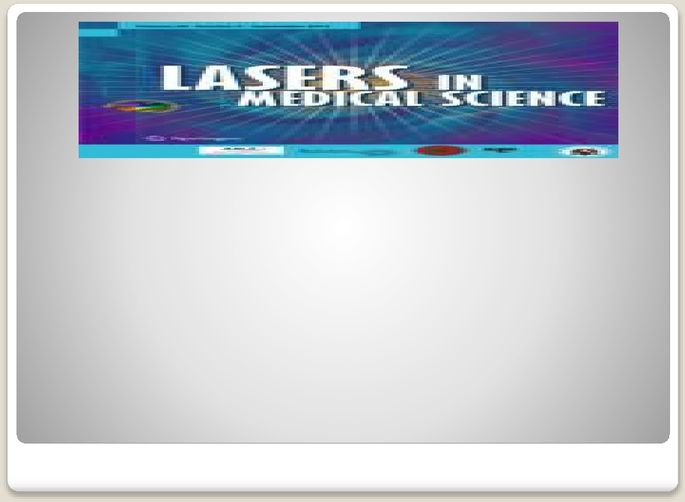
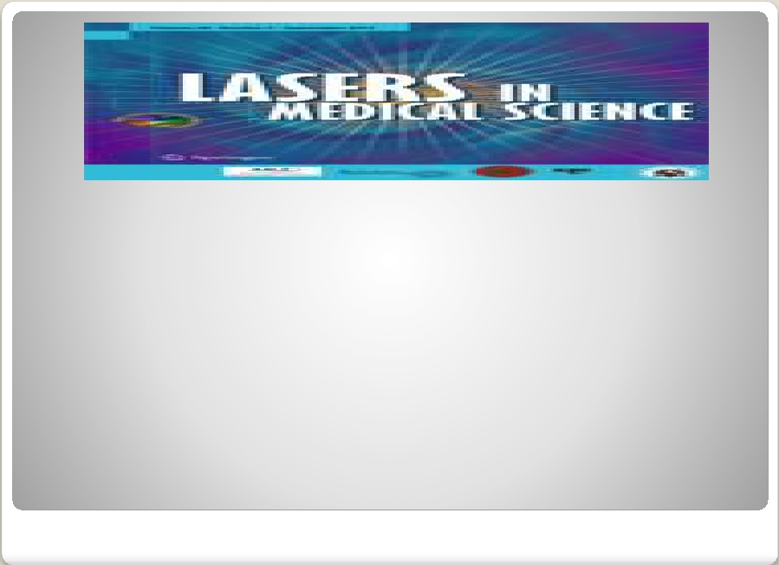
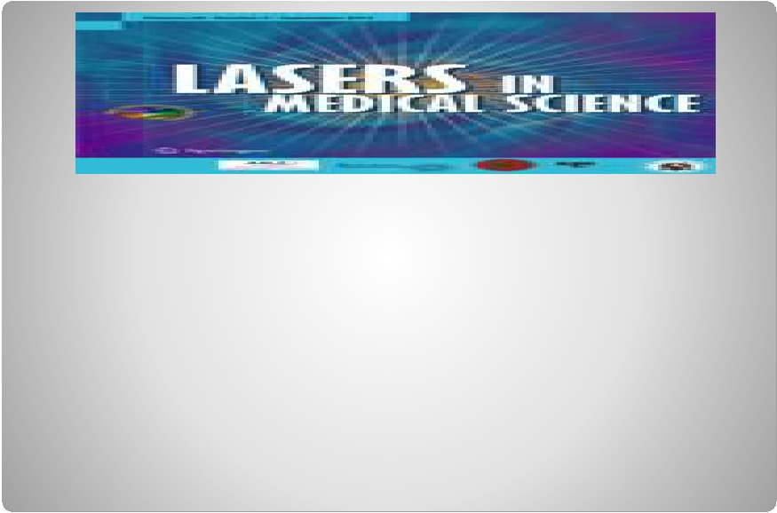
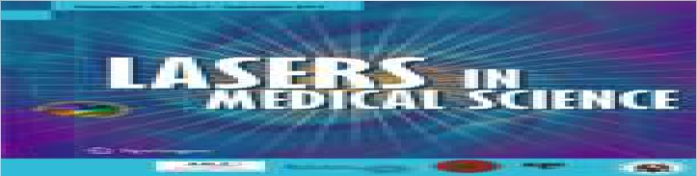
➢ Argon and Co2 lasers are used in treatment of liver
and lungs .
➢ New kind of laser surgery that uses molecules to
stitch together wounds .
➢ Co2 laser is particularly used in spinal and brain
tumour excision and kidney stone extrusion.
➢ Lasers are used in the treatment of Glaucoma.

Slide 20
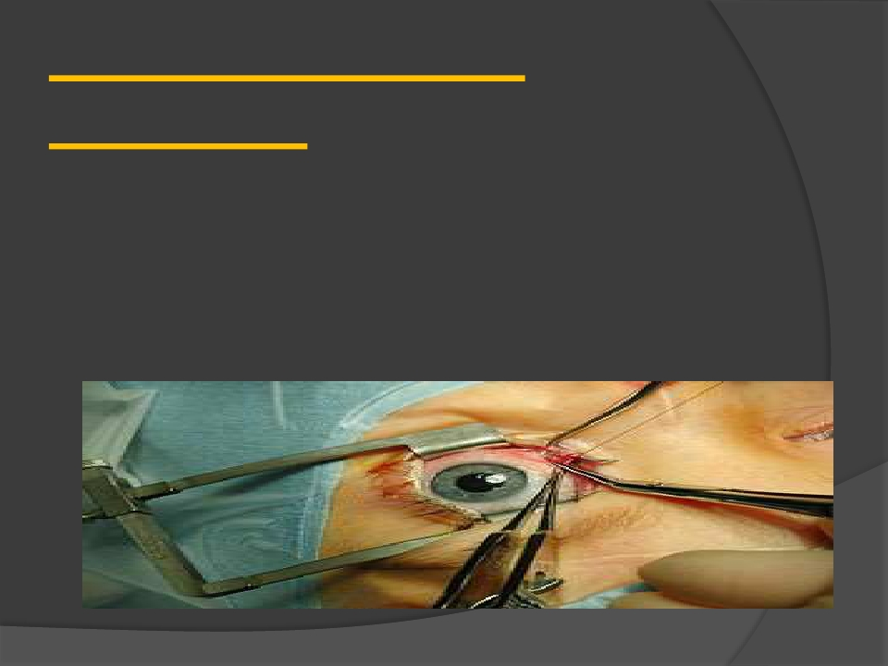
Laser used in eye
treatment
·
·
The laser can also repair a detached retina — one that
has broken loose from the rear part of the eyeball
The laser is very useful in removing extraneous blood
vessels that can form on the retina — the thin, light-
sensitive membrane at the back of the eyeball

Slide 21
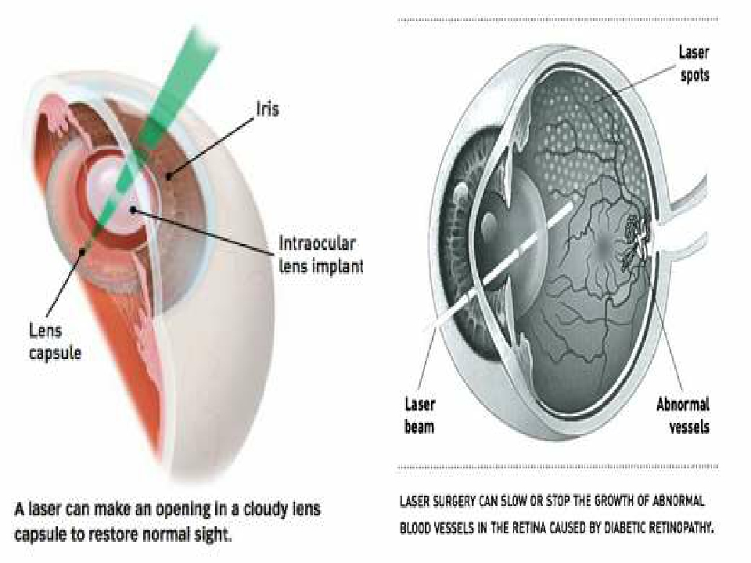

Slide 22
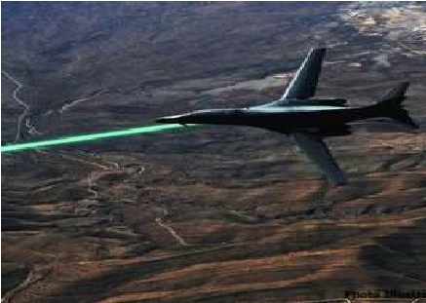
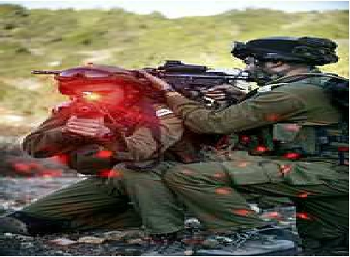
Lasers in military:
➢ A laser beam can be bounced off a target such as
enemy air plane or ship,to determine its distance
and speed.
➢ Laser can serve as a war weapon.
➢ High energy lasers are being employed to destroy
enemy air crafts and missiles.

Slide 23

Advantages of lasers
➢
➢
➢
➢
Lasers are used to cut glass and drill holes in
ceramics.
Lasers are used for bloodless surgery and in
destroying kidney stones and gallstones.
Lasers are used to study the internal
structure of microorganisms and cells.
Lasers are used in air pollution, to estimate
the size of dust particles.

Slide 24

Disadvantages of lasers
➢ Lasers are known to be dangerous to the
atmosphere and health.
➢ Laser printers are very costly when compared to
other printers.
➢ When running the laser machine small amount of
ozone are generated, which can damage the
ozone layer.
➢ Some laser particles are also known to emit
particles that may cause respiratory disease.

Slide 25
CONCLUSION
 Finally I conclude that laser
plays a crucial role in the
modern world.
 Therefore laser play an pivotal
role in the present technical
world.

Slide 26




Slide 27





